Slide 1
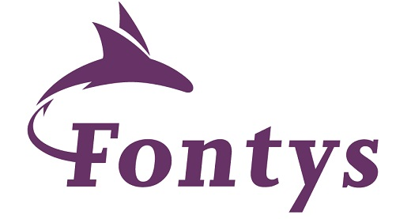

Business and IT agility through microservice architecture powered by containers and cloud
Fontys Hogeschool, Eindhoven, 1 april 2019
Lucas Jellema, CTO & Architect AMIS, Oracle Groundbreaker Ambassador
Notes:
Business and IT agility through microservice architecture powered by containers and cloud
Evolving architectures, emerging technology and new cloud services enable new ways to address business challenges with IT solutions. Microservices architecture promises flexibility, scalability, and optimal use of compute resources. This lecture introduces the objectives that microservices are expected to realize and explains how microservices will do that. The lecture describes the key concepts – domain driven design, bounded context, events, statelessness and APIs. It discusses and demonstrates a real implementation of microservices using containers and Kubernetes.
Students will do a hands-on with the Kubernetes platform – learning about the container orchestration features that allow microservices to be deployed, scaled, configured, failed over, and upgraded to new versions while maintaining proper routing and load balancing. Students will learn how to make use of Kubernetes for running multiple interacting containers executing applications written in the technology of their choice.
The lectures discusses the service mesh and challenges with tracing and end to end monitoring. The relevance of events for decoupled collaboration is discussed and demonstrated. Concepts discussed include workflow choreography, the CQRS data(base) pattern for cross domain data sharing and serverless architecture.
In order to participate in the hands on sections of this session, students are requested to bring their laptops. No additional installation is required.

Slide 2
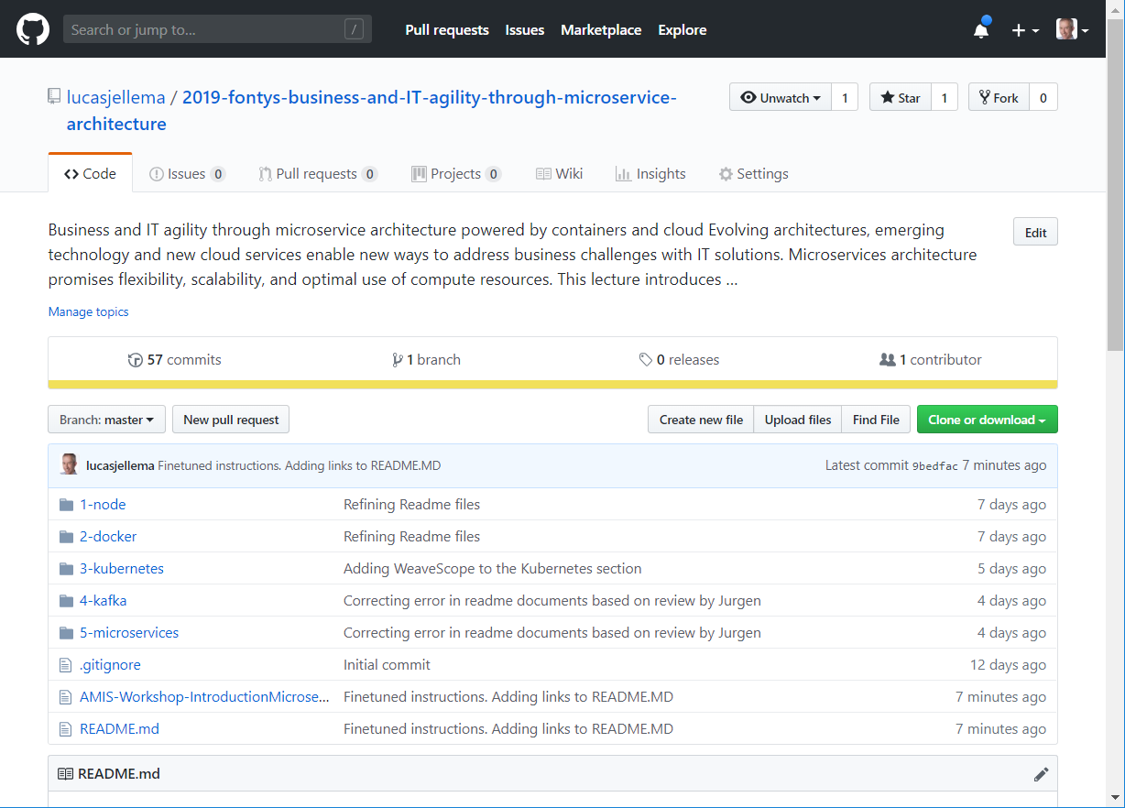
To get the slides and workshop materials: http://bit.ly/fontys1april

Slide 3
Overview
Introduction AMIS & Conclusion
Business Objectives and IT requirements
Microservices architecture – what, why, how
domain driven design, bounded context, events, statelessness and APIs
Introducing Cloud, Containers and the Container Platform: Kubernetes
Hands On: Docker Containers & Kubernetes
Microservices concepts
workflow choreography, the CQRS data(base) pattern for cross domain data sharing and serverless architecture, service mesh and operational challenges
Hands On: Do It Yourself Microservices and introduction Apache Kafka

Slide 4
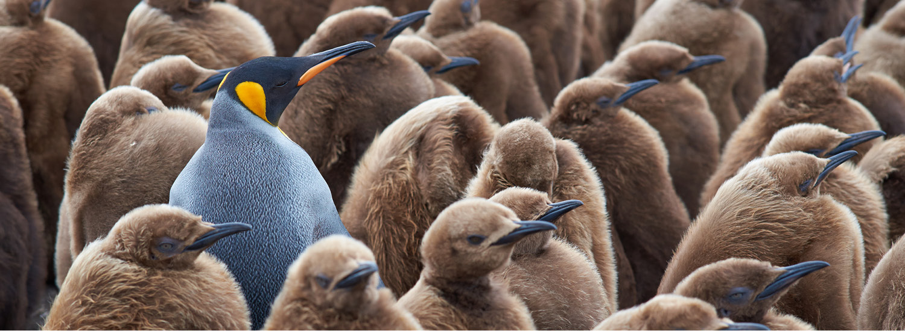
Introductie van AMIS

Slide 5
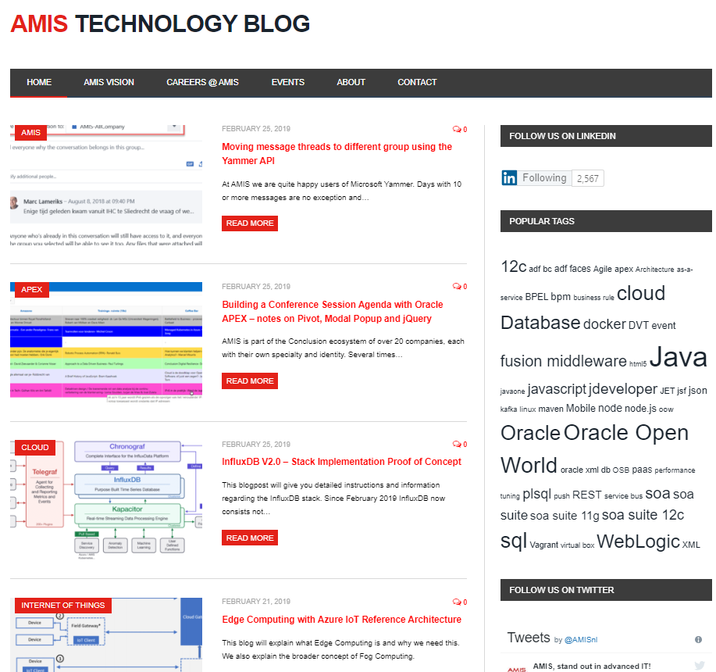

Wie en Wat is AMIS?
100 medewerkers
Opgericht in 1991 (als Aircraft Maintenance Information System)
Oracle specialist – nationaal en internationaal
Nieuw Caledonië, UK, Canada, USA, Faroër, Denemarken, Duitsland, België, Koeweit, Mongolië, Frankrijk
Overheid, Logistiek, Financiën, Retail, Food, Industrie, Landbouw, (Zorg, Onderwijs, Bouw)
Lid van Red Expert Alliance
Breder focus – cloud, data, architectuur, business, DevOps, IoT

Slide 6



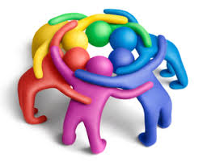




Over …
Lef
Passie
Betrokken
Vertrouwen
Vernieuwend
Persoonlijk
Meesterschap

Slide 7
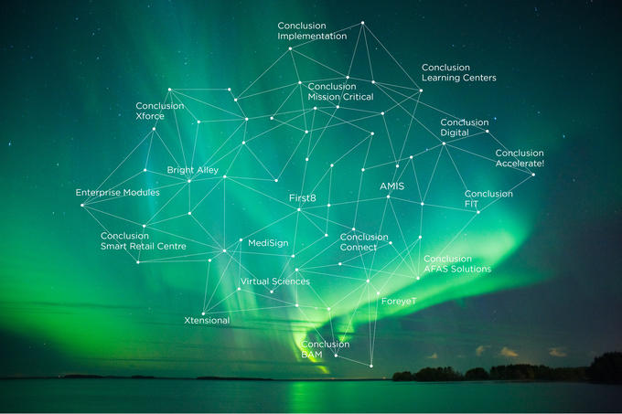
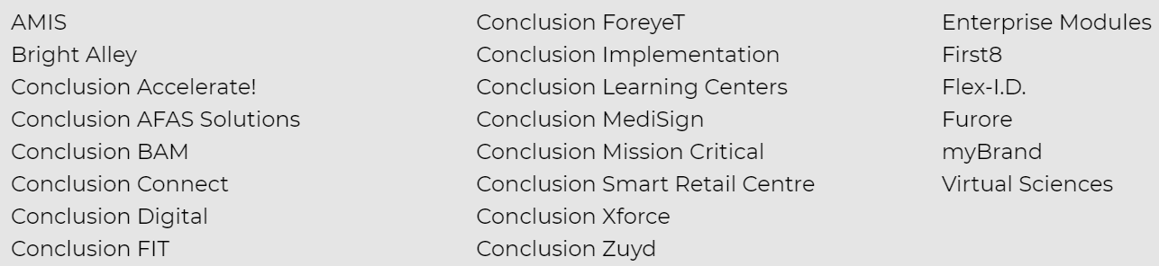
AMIS is lid van het Conclusion ecosysteem
(Sinds 2012)
Eén organisatie
24 bedrijven en labels
Eigen specialisme en niche
Meestal zelfstandig gegroeid en aangesloten bij ecosysteem
Synergie en onafhankelijkheid

Slide 8


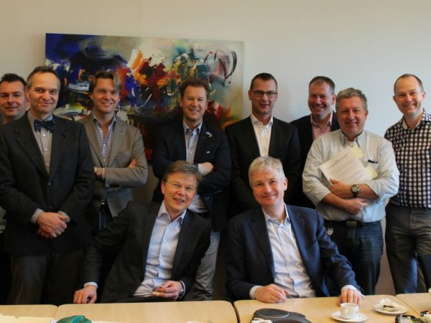
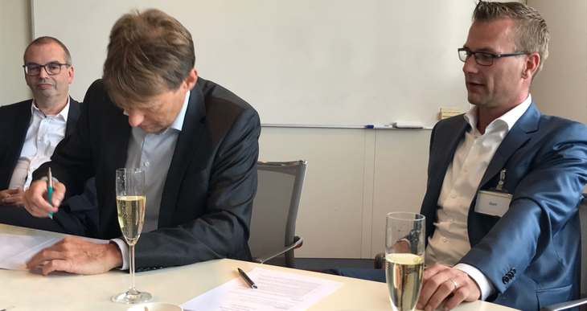

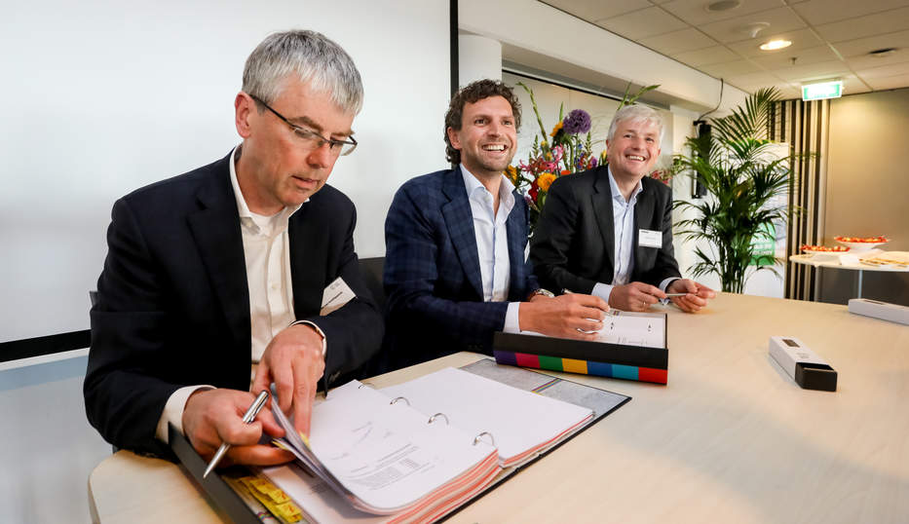


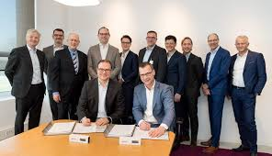

AMIS is lid van het Conclusion ecosysteem

Slide 9
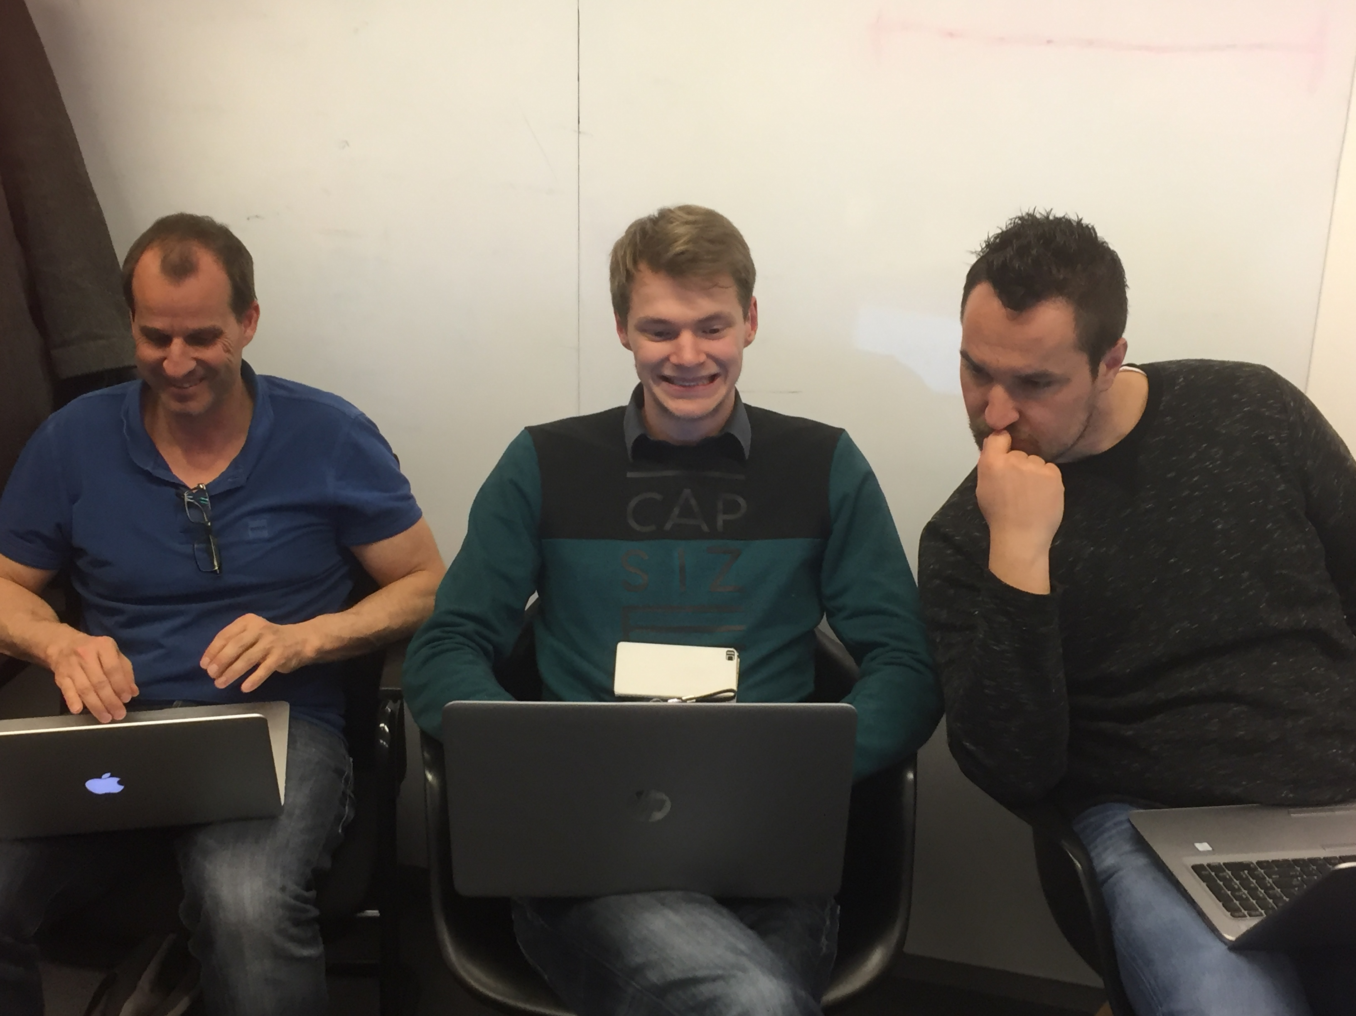
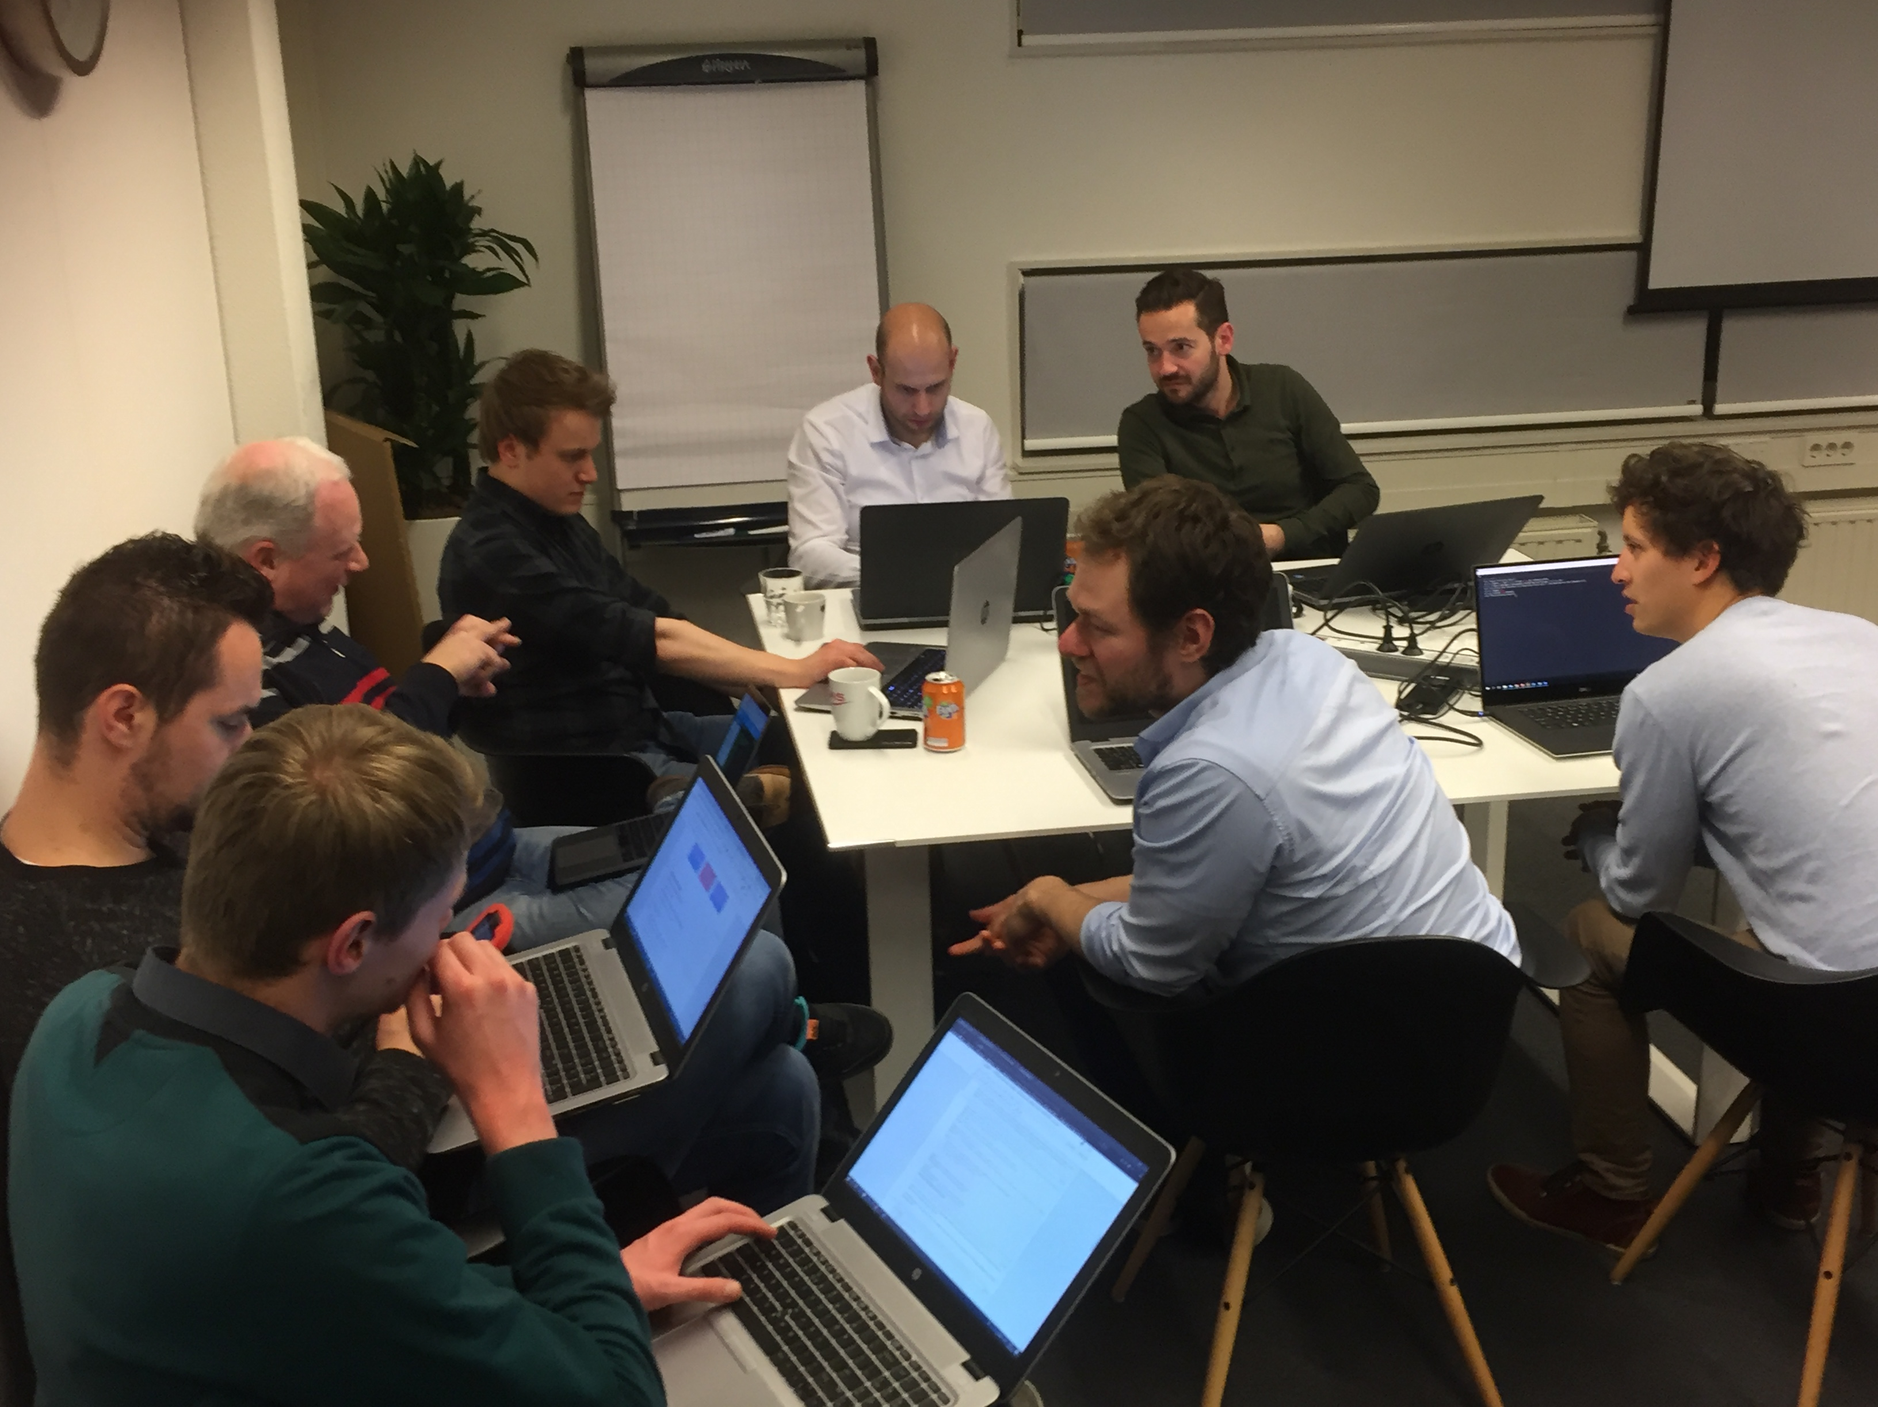
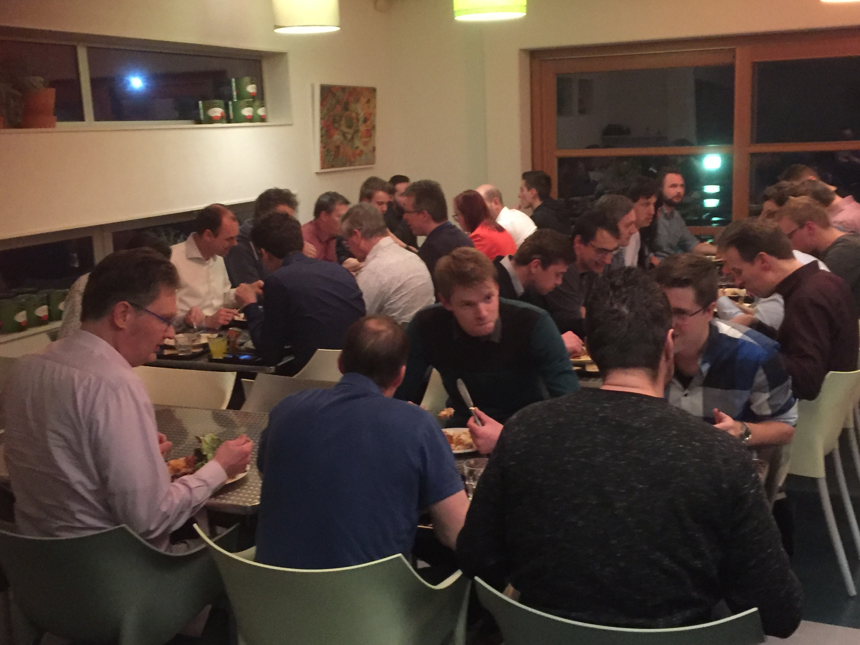
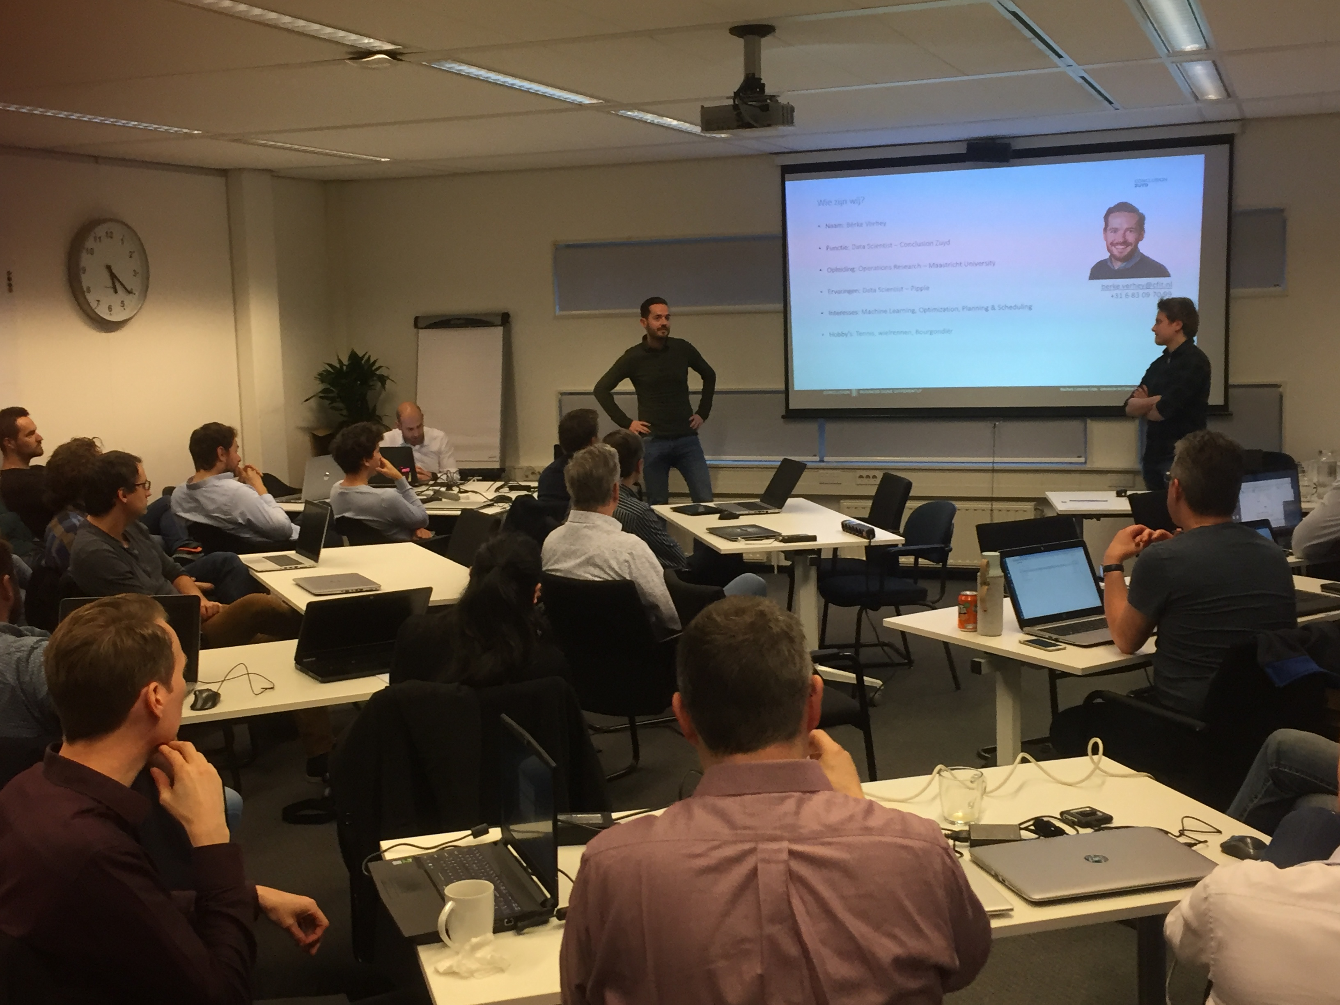
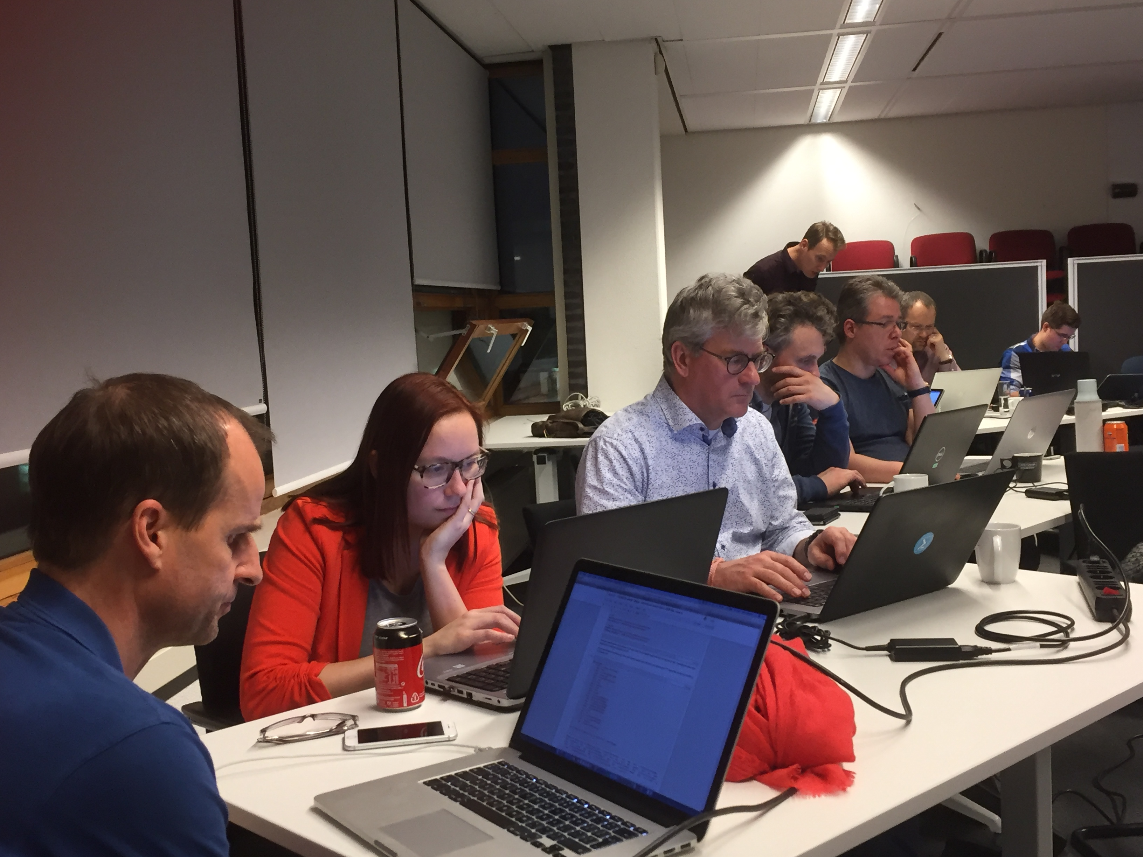
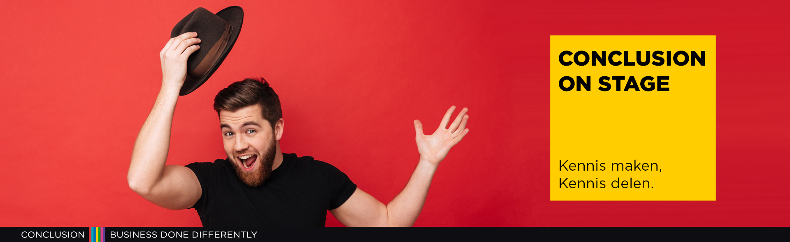
Het Ecosysteem in actie
Foto’s Gilde sessies

Slide 10
Onze bouwstenen
SaaS-Enablement
Integratie
Data
(Analytics)
Applicatie-ontwikkeling
Front-end
IoT
Managed Services
Platformbeheer
Applicatiebeheer
Strategie, Architectuur, Regie

Slide 11
Ontwikkelingen/Thema’s
Cloud
Security
Agile – quick start, rapid scale
Innovation – try out new technology, start and abandon pilots
Lifecycle and evolution platform technology
Investments vendors in cloud - new functionality not on premises
Do not invest in [and rely on] capital and people and effort for non-business specific purposes
Buy before build
Invest less in IT
CAPEX vs OPEX, TCO
Managed, Automated, Autonomous
(Easier access to) scale and availability

Slide 12
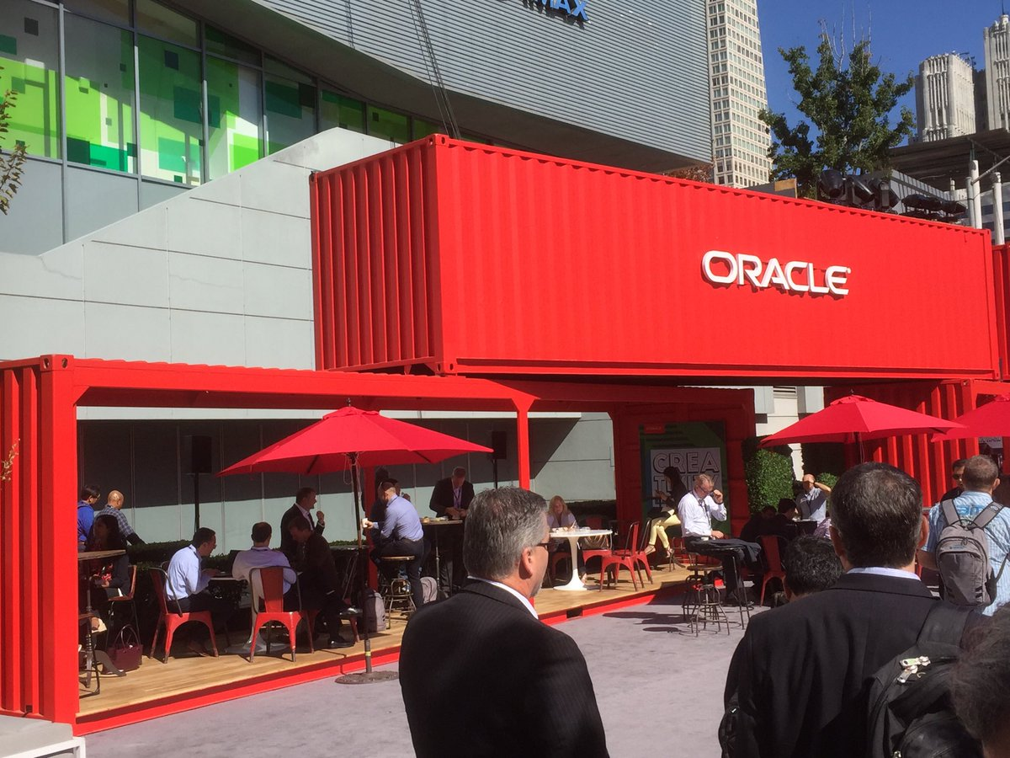

Business and IT agility through microservice architecture powered by containers and cloud
Notes:
The microservices architecture promises flexibility, scalability, and optimal use of compute resources.
Via independent components with well-defined scope and responsibility, interface, and ownership that are evolved and managed in an automated DevOps process, this architecture leverages current technologies and hard-learned insights from past decades.
This session demonstrates how to implement, roll out, and manage a set of collaborating microservices on Oracle Cloud, using services such as
container (Docker) and Oracle Application Container Cloud,
event hubs, Oracle Container Engine (Kubernetes),
Oracle Identity Cloud Service,
Oracle Data Hub Cloud Service,
Wercker, Oracle Visual Builder Cloud Service, and Fn serverless platform
and open source tools: Istio, Prometheus, Zipkin, Grafana.

Slide 13
Overview
Introduction AMIS & Conclusion
Business Objectives and IT requirements
Microservices architecture – what, why, how
domain driven design, bounded context, events, statelessness and APIs
Introducing Cloud, Containers and the Container Platform: Kubernetes
Hands On: Kubernetes
Microservices concepts
workflow choreography, the CQRS data(base) pattern for cross domain data sharing and serverless architecture, service mesh and operational challenges
Hands On: Do It Yourself Microservices

Slide 14

How do we implement microservices?
And how we make the containers horizontally scalable
How do we get from a Monolith to Microservices?

Slide 15
Why? What? How?
Notes:
Objectives
Requirements
Specifications

Slide 16
What is IT all about?
Production Runtime
Application

Slide 17
What is IT all about?
Production Runtime
Application
Platform

Slide 18
Objectives
Business Agility
In functionality: quick, cheap, effortless and risk free
IT Agility
In non-functionality: scale, resilience, infrastructure & location
Real working applications with rapid relevant evolution that run reliably

Slide 19
What is IT all about?
Production Runtime
Operations
Monitoring & Management
Application
Platform
Platform
Platform

Slide 20
Production Runtime is the Result of Preparation Runtime
Preparation Runtime
Production Runtime
Development
Operations
Monitoring & Management
Application
Application
Agile Design, Build, Test
Platform
Platform
CD

Slide 21
What?

Slide 22
One team has Agile responsibility through full lifecyle
Preparation Runtime
Production Runtime
Development
Operations
Monitoring & Management
Application
Application
Agile Design, Build, Test
Platform
Platform
CD

Slide 23
One team has Agile responsibility through full lifecyle
Preparation Runtime
Production Runtime
DevOps
Development
Operations
Monitoring & Management
Application
Application
Agile Design, Build, Test
Platform
Platform
CD
You build it, you run it, you fix it, you evolve

Slide 24
One team has Agile responsibility through full lifecyle
DevOps
Application
Application
Platform
Platform
You build it, you run it, you fix it, you evolve

Slide 25
DevOps team owns and runs one (or more) products
Application
Platform
Generic Infrastructure Platform for running DevOps Products
Floorspace, Power, Cooling, Storage, Compute
Monitoring, Management, Cache, Authentication, RDBMS, Event Hub

Slide 26
Multiple products from multiple teams run on a shared generic infrastructure
Application
Application
Application
Application
Application
Platform
Platform
Platform
Platform
Platform
Generic Infrastructure Platform for running DevOps Products
Floorspace, Power, Cooling, Storage, Compute
Monitoring, Management, Cache, Authentication, RDBMS, Event Hub

Slide 27
(Application plus platform)under DevOps ==
µ
µ
µ
µ
µ
Generic Infrastructure Platform for running DevOps Products
Microservice

Slide 28
Software Objectives
Develop/evolve
At scale (teams)
Agile
Innovative technology
Quick ramp up (new team members)
Manage
Agile (quick, reliable rollout)
Scaleable
Reliable
Physically distributed
Robust (if one part fails, not everything is dragged down)

Slide 29

What?
Realistic approach (technology, people, process) => Something that works!
No dependency on individuals
Able to scale in rate of change
Small, well: comprehensible, manageable
Clear business ownership
Stand alone /isolated/encapsulated (in terms of change, release/deploy, scale, location, implementation technology)
Provide clear and meaningful functionality in a way that it can be consumed
One microservice does not completely fall over when other microservices break (or are redeployed)
Able to scale elastically & horizontally and relocate easily
A microservice exists within a single bounded context
Multiple microservices can share the same bounded context

Slide 30
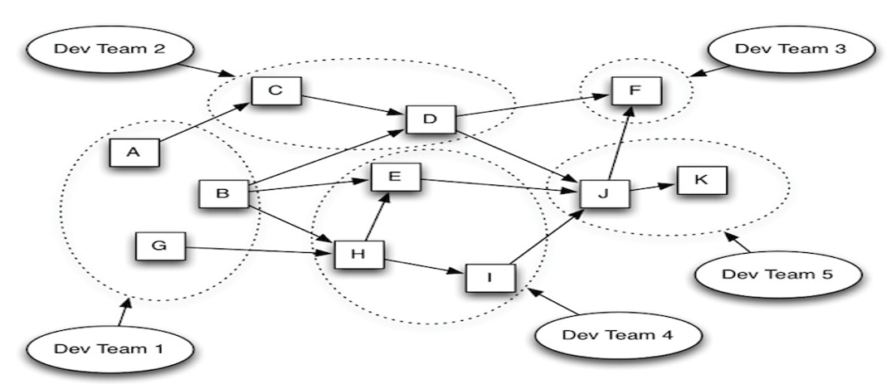
Microservices Architecture
Bounded Context or Domain, Team Ownership, Loose dependencies outside domains, independently (re)deployable components

Slide 31
scale
own
test
monitor
deploy
organize
manage
scale
scale
own
test
monitor
own
test
monitor
organize
deploy
organize
deploy
manage
scale
manage
µ
own
test
monitor
organize
deploy
µ
µ
manage
µ
own
test
scale
vs.
scale
organize
deploy
monitor
own
test
monitor
µ
manage
own
test
scale
own
test
scale
organize
deploy
deploy
monitor
organize
deploy
monitor
µ
manage
organize
manage
µ
manage
µ
own
test
scale
organize
deploy
monitor
own
test
scale
µ
manage
organize
deploy
monitor
µ
manage

Slide 32
µ
µ
[mini] µonolith
µ
µ

Slide 33
Owned by Business Manager X
High Change Rate
Highly Available
Needs to scale up to 10x between 7-10PM
Can be done by team of 5
µ
µ
Owned by Business Manager Y
Business Hours availability
Some Highly Secure Data
Fairly constant load
Very strict QA steps in CI/CD process
Can be done by team of 3

Slide 34
Webshop
Web Shop Portal
Backend
Notes:
dazzle the audience with a quick dump of all technologies (and cloud services) used for putting the webshop together - for the UI, the API implementation, the datastores and the event bus.

Slide 35
Microservices based Webshop
Web Shop Portal
µ Customers
µ Orders
µ Products
µ Loyalty
µ Finance
µ Logistics
µ Customers
µ Orders
µ Products
µ Loyalty
µ Finance
Notes:
dazzle the audience with a quick dump of all technologies (and cloud services) used for putting the webshop together - for the UI, the API implementation, the datastores and the event bus.

Slide 36
Warehousing
µ Logistics
µ
Shipping

Slide 37
How?

Slide 38
How microservices
One team owns the microservice and can do functional and technical evolution and deployment continuously and independently
The business ownership is clearly defined
Application
Platform

Slide 39
The Microservice
HTTP REST/JSON
API

Slide 40
Extended API of microservice
API
Deployment API
Injectable dependencies – reference to cache, logging, storage URL, …
Configurable meta-data – run time parameters, log level, credential (key)
Interaction API
REST Resources & Operations – query and URL parameters, message formats
Events Consumed – alternative way to call | activate a microservice
Reference to entry in Event Catalog
May include reference to shared Cache Resource
Events Produced – alternative output from microservice
Event can be an asynchronous response to a stateless consumer

Slide 41
How? Run & Operate

Slide 42
Run & Operate Microservices
µ
µ
µ
µ
µ
Rapid rollout
Including scale out & recover
Non breaking upgrade & rollback strategies (e.g. canary release)
Agile infrastructure
Relocate, independent of infra specifics
Health management
Monitor and safeguard SLA requirements on response time, success and availability
Scale elastically
TCO management
DevOps: one team creates and runs
Generic Infrastructure Platform for running DevOps Products

Slide 43
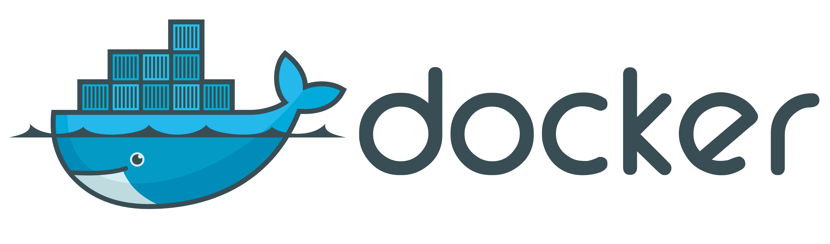



The elephant in the room…
whale

Slide 44
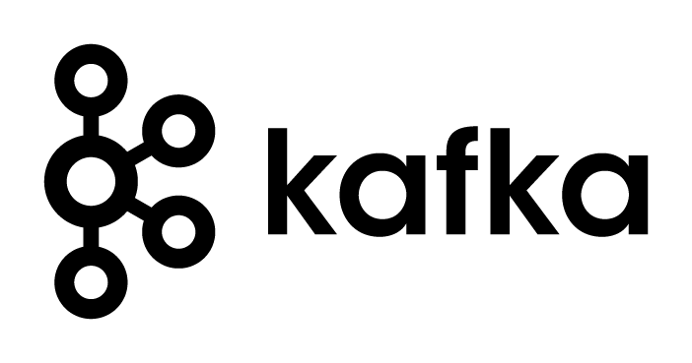

Setup for Oracle OpenWorld Demo What I needed
Local installation of a Kafka Cluster
At least one Broker node and the Zookeeper
Demo Application
Kafka Broker
Zookeeper

Slide 45

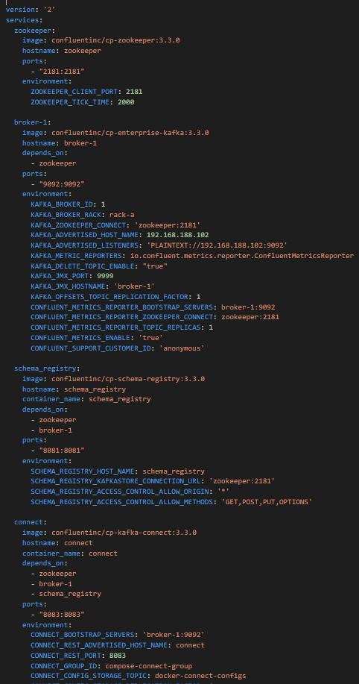
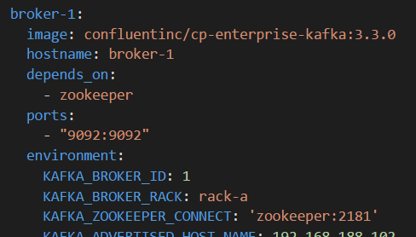
Setup for Oracle OpenWorld Demo What I received from Guido
Simple text file – 140 lines
Name of Docker image to run
Hostname on internal network between Docker containers
Dependency on other container (to start first)
Container port to expose externally
Environment variable to pass to container

Slide 46

Setup for Oracle OpenWorld Demo What I created in a few minutes
9092
Kafka Broker
8084
2181
Kafka
Rest Proxy
Zookeeper
8081
Kafka
Schema Registry
8083
8001
Kafka
Connect
Kafka Connect UI
9000
8002
Kafka Manager
Kafka
Schema Registry UI

Slide 47

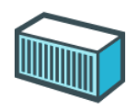
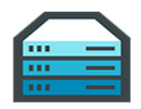
Some Quick Conclusions
Docker provides a great way to
Build environments (application & platform) (from simple, text based build files & public images)
Share & Ship these environments (either through build files or through ready-to-run images)
Run environments making efficient use of physical resources (that can be complex and have complex interdependencies)
And Guido is a very nice guy
And also:
[Docker] Containers are pivotal in cloud native environments, microservices architecture, DevOps and CD
Any IT professional should know her or his way around containers

Slide 48
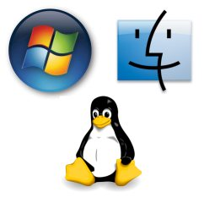
Linux essentials
Applications share resources
Memory
Network interface
IP address
Ports
Users & groups
Environment Variables
Packages
Services
Application A
CPUs
Application B
Application C
Disk Storage

Slide 49
Linux essentials: Control Groups and Namespaces
Compartmentalize Resources into isolated units
Memory
Network interface
IP address
Ports
Users & groups
Environment Variables
Packages
Services
Network interface
IP address
Ports
Users & groups
Environment Variables
Packages
Services
Network interface
IP address
Ports
Users & groups
Environment Variables
Packages
Services
CPUs
Network interface
IP address
Ports
Users & groups
Environment Variables
Packages
Services
Network interface
IP address
Ports
Users & groups
Environment Variables
Packages
Services
Disk Storage

Slide 50
Linux essentials: Control Groups and Namespaces
Expose units through mapped network ports
Memory
Network interface
IP address
Ports
Users & groups
Environment Variables
Packages
Services
Network interface
IP address
Ports
Users & groups
Environment Variables
Packages
Services
Network interface
IP address
Ports
Users & groups
Environment Variables
Packages
Services
CPUs
Network interface
IP address
Ports
Users & groups
Environment Variables
Packages
Services
Network interface
IP address
Ports
Users & groups
Environment Variables
Packages
Services
Disk Storage

Slide 51

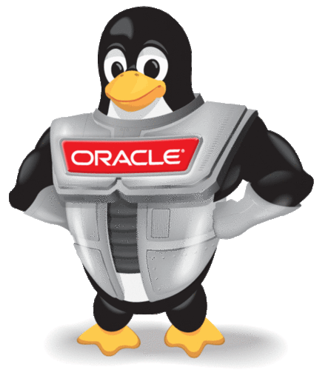




Linux essentials: Each unit runs its own processes
Units run their own processes:
OS (Linux)
Platform
Application
Memory
Network interface
IP address
Ports
Users & groups
Environment Variables
Packages
Services
Application A
Network interface
IP address
Ports
Users & groups
Environment Variables
Packages
Services
Application B
CPUs
Network interface
IP address
Ports
Users & groups
Environment Variables
Packages
Services
Application C
Network interface
IP address
Ports
Users & groups
Environment Variables
Packages
Services
Network interface
IP address
Ports
Users & groups
Environment Variables
Packages
Services
Disk Storage

Slide 52

This stuff is complex
Core Linux features were hard to use
Memory
Network interface
IP address
Ports
Users & groups
Environment Variables
Packages
Services
Application A
Network interface
IP address
Ports
Users & groups
Environment Variables
Packages
Services
Application B
CPUs
Network interface
IP address
Ports
Users & groups
Environment Variables
Packages
Services
Application C
Network interface
IP address
Ports
Users & groups
Environment Variables
Packages
Services
Network interface
IP address
Ports
Users & groups
Environment Variables
Packages
Services
Disk Storage

Slide 53
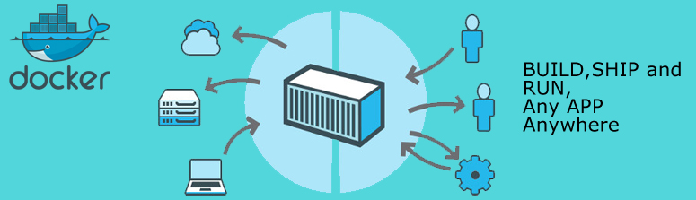
Docker has democratized Linux Containers
Container Image – a serialized file from which we can instantiate a container
Container Build script and workflow – to automate the creation of a container (image) using straightforward vocabulary
Engine – runtime platform for instantiating, running and managing containers, volumes and networks (REST API and CLI)
Docker Registry – Repository for Container Images
And now also Docker Store
Memory
Network interface
IP address
Ports
Users & groups
Environment Variables
Packages
Services
Application A
Network interface
IP address
Ports
Users & groups
Environment Variables
Packages
Services
Application B
CPUs
Network interface
IP address
Ports
Users & groups
Environment Variables
Packages
Services
Application C
Network interface
IP address
Ports
Users & groups
Environment Variables
Packages
Services
Network interface
IP address
Ports
Users & groups
Environment Variables
Packages
Services
Disk Storage

Slide 54
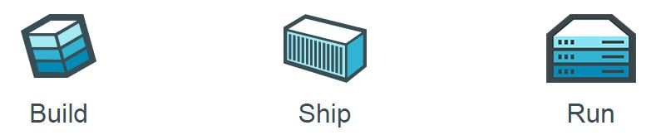


Running Containers using Docker
Docker Hub
Create Container(s) from Image plus:
Port mapping
Volume
Environment Variable
(inter container) Network
Startup script
Container images
Memory
Network interface
IP address
Ports
Users & groups
Environment Variables
Packages
Services
Application A
Network interface
IP address
Ports
Users & groups
Environment Variables
Packages
Services
Application B
CPUs
Application C
Network interface
IP address
Ports
Users & groups
Environment Variables
Packages
Services
Network interface
IP address
Ports
Users & groups
Environment Variables
Packages
Services
Docker Engine
Disk Storage

Slide 55
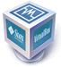
Running Containers using Docker on Windows
Docker is a Linux mechanism
In order to run on a Windows server, we use
a Linux VM on VirtualBox
Docker for Windows on Hyper-V
…
It is possible to run the Docker Engine inside a Docker Container
Docker Container inside Docker Container [inside VM]
Memory
Network interface
IP address
Ports
Users & groups
Environment Variables
Packages
Services
Application A
Network interface
IP address
Ports
Users & groups
Environment Variables
Packages
Services
Application B
CPUs
Network interface
IP address
Ports
Users & groups
Environment Variables
Packages
Services
Application C
Network interface
IP address
Ports
Users & groups
Environment Variables
Packages
Services
Network interface
IP address
Ports
Users & groups
Environment Variables
Packages
Services
Disk Storage

Slide 56
Run container image on Docker host
Running Docker Containers

Slide 57
Running Containers using Docker
Docker Hub
Application A
docker run
--name ApplicationA
amis/NodeAppRunnerImage:latest
/bin/bash
amis/NodeAppRunnerImage:1.4
Application A
ApplicationA
Docker Engine

Slide 58
Running Containers using Docker
Docker Hub
Application A
docker run
--name ApplicationA
-p 8010:8080 -p 8011:1521
--network=myBridgeNW
-e APP_HOME=/home/apps/applicationA -e PARAM1=value1
amis/NodeAppRunnerImage:latest
/bin/bash
amis/NodeAppRunnerImage:1.4
8010
8080
8011
1521
Application A
APP_HOME= /home/apps/applicationA
ApplicationA
PARAM1=value1
Docker Engine

Slide 59
Running Containers using Docker
Docker Hub
Application A
docker run
--name ApplicationA
-p 8010:8080 -p 8011:1521
--network=myBridgeNW
-v /hostworkdir
-v /tmp/files:/host_files
--volumes-from dataContainer
-e APP_HOME=/home/apps/applicationA -e PARAM1=value1
amis/NodeAppRunnerImage:latest
/bin/bash
amis/NodeAppRunnerImage:1.4
8010
8080
8011
1521
Application A
APP_HOME= /home/apps/applicationA
ApplicationA
PARAM1=value1
dataContainer
Docker Engine
Disk Storage
/host_files
/data

Slide 60
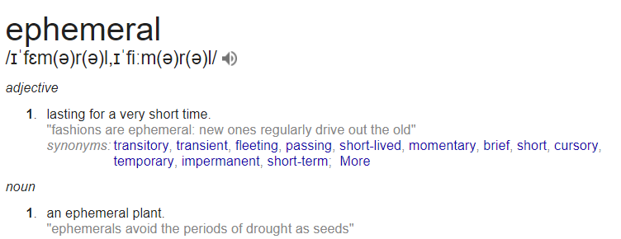
Containers are ephemeral (*
(* Candidate for IT word of the year 2018

Slide 61
Container state that needs to survive should be on an externally mapped volume
/data
-v /data:/u01/app/data
--mount source=/u01,target= /u01/app/data
Host Disk Volume
Cloud Native Storage
(AWS S3, ….)
/u01/app/data

Slide 62


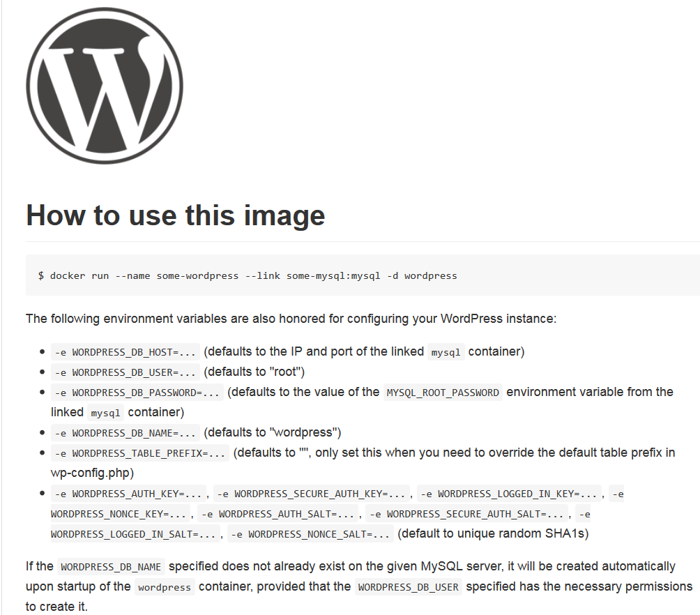
Implicit Docker Container Image Interface: environment variables, ports, volumes
Docker Hub
Parameters:
WORDPRESS_DB_PASSWORD, WORDPRESS_DB_USER, …
link mysql
Parameters:
MYSQL_DATABASE, MYSQL_ROOT_PASSWORD
Volume
..:/var/lib /mysql

Slide 63
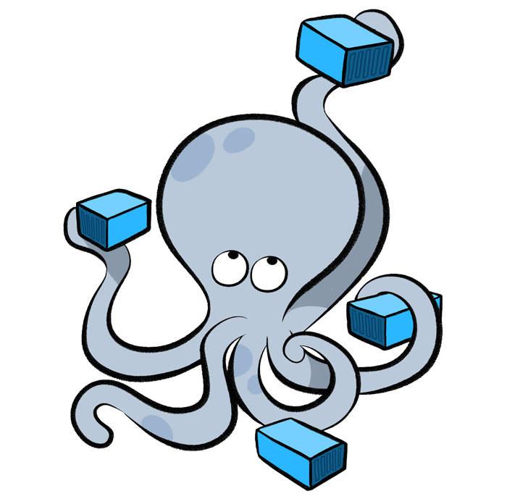
Running and Managing Containers
Start | Pause | Stop | Delete | Export | Import containers
Save | Load Images
List containers | images | networks | …
Inspect container
Run multiple instances of an image
Execute into running container
Attach to (standard input | output | error stream of) running container
Get Container Logs
Create Network
Connect container to network
Experimental feature: Snapshot (CRIU)

Slide 64
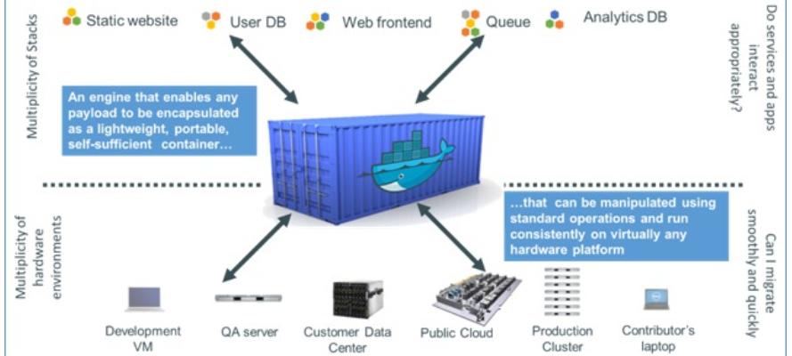
Ship (Container Images)
Package, Distribute, Share, Publish and Consume container images
The frozen state of a container (committed after building and further manipulating)
With everything needed to run the micro service: application and underlying platform & OS, ready to run on any Docker Engine anywhere
With an implicit interface (environment variables, ports, volume)

Slide 65
Docker Image Registry
Public Docker Registry
Docker Hub
push
pull &run
Private Docker Registry
Docker Hub
push
pull &run

Slide 66
Container Use Cases for IT professionals
R&D (aka Play) – try out technology
Quickly, easily, cleanly
Complex, multi-node configurations
Leverage huge number of resources available out in the open
Prepare and Share (running) environments for
Playing, Training, Testing, Beta-testing,
Deploy and Run application on generic cloud infrastructure
Especially ephemeral (stateless) and dynamically scalable
Streamlined CD across Development, Test and Production
Prepare for Cloud (consolidate, lift & shift workloads)
Analysis & What If Scenarios
Clone an environment, spin up, investigate, tear down & quit
Automated Testing
Against rich dataset with minimum set up and tear down
Microservices – implement, deploy and run

Slide 67
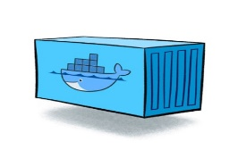
Containers
As vehicle for:
Encapsulate
Build
Share & Ship
Automated Tests
Deploy
Run
Scale
Relocate
Standardize

Slide 68
Looking for a runtime platform for
Compute Node
Notes:
Deploy and Run (Docker Containers)
Distributed infrastructure (scalable and available)
Hide infrastructure from DevOps teams
Auto-healing
Elastic Scale
Wire up the micros – connect dynamically (service discovery)
Load Balance
Provide Persistent storage
Rolling Upgrade
Configuration & Secret Management
Secure

Slide 69
Looking for a runtime platform for
Compute Node
Compute Node
Compute Node
Notes:
Deploy and Run (Docker Containers)
Distributed infrastructure (scalable and available)
Hide infrastructure from DevOps teams
Auto-healing
Elastic Scale
Wire up the micros – connect dynamically (service discovery)
Load Balance
Provide Persistent storage
Rolling Upgrade
Configuration & Secret Management
Secure

Slide 70
Looking for a runtime platform for
Compute Node
Compute Node
Compute Node
Notes:
Deploy and Run (Docker Containers)
Distributed infrastructure (scalable and available)
Hide infrastructure from DevOps teams
Auto-healing
Elastic Scale
Wire up the micros – connect dynamically (service discovery)
Load Balance
Provide Persistent storage
Rolling Upgrade
Configuration & Secret Management
Secure

Slide 71
Looking for a runtime platform for
Compute Node
Compute Node
Compute Node

Slide 72
Looking for a runtime platform for
Compute Node
Compute Node
Compute Node

Slide 73
Looking for a runtime platform for
Compute Node
Compute Node
Compute Node
Cloud Storage
SAN

Slide 74
Looking for a runtime platform for
Configuration Map
Configuration Map
Compute Node
Compute Node
Compute Node
Cloud Storage
SAN

Slide 75

Looking for a runtime platform for
Compute Node
Compute Node
Compute Node

Slide 76
Looking for a runtime platform for
Compute Node
Compute Node
Compute Node
Compute Node
Compute Node

Slide 77
Looking for a runtime platform for
Compute Node
Compute Node
Compute Node

Slide 78
Looking for a runtime platform for
v2
v2
v2
Compute Node
v2
v2
Compute Node
Compute Node

Slide 79
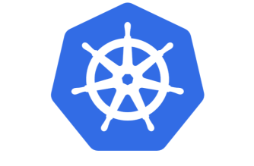

Slide 80
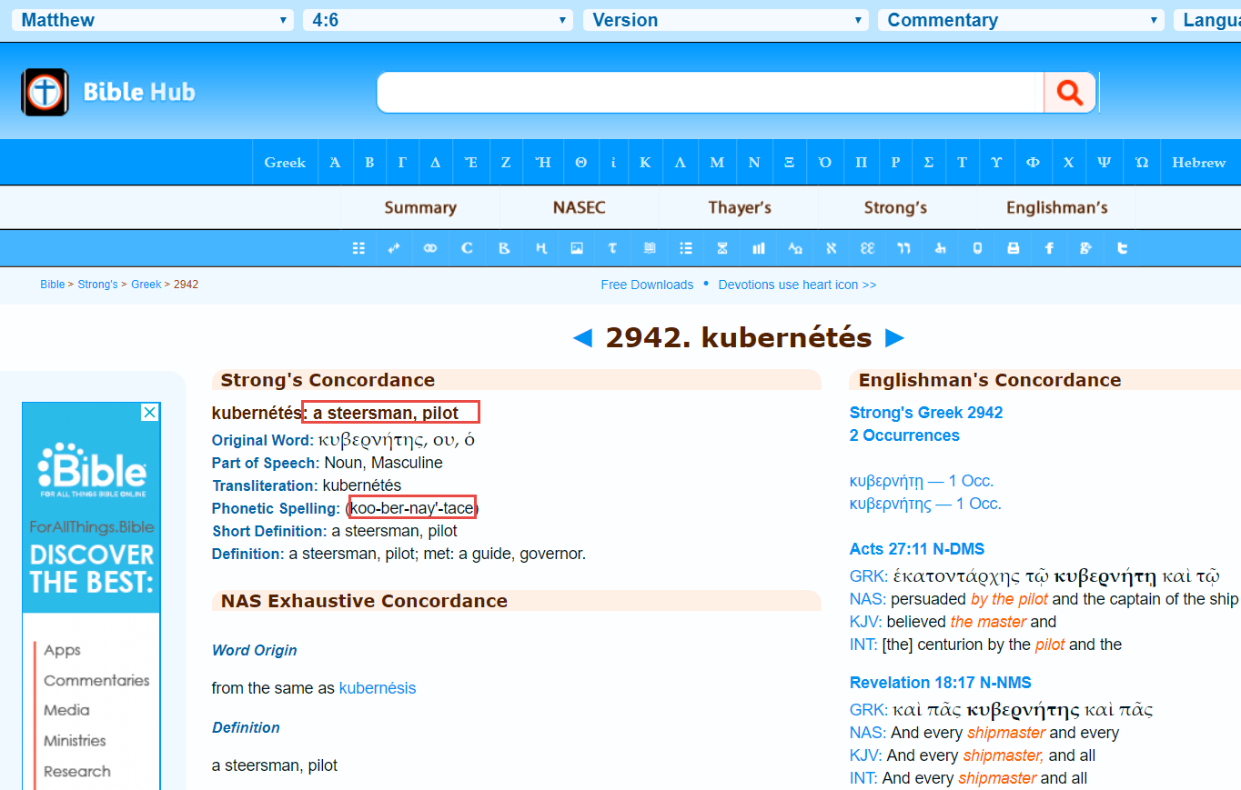

Slide 81
Introducing Kubernetes
Distributed Container Run Time Management platform
Based on Google’s Borg system (in use at Google for over a decade)
Initial announcement: 2014
Kubernetes v1.0 was released on July 21, 2015
A Kubernetes cluster typically spans multiple compute nodes
Either in the cloud, on premises, on a single machine (minikube) or hybrid
K8S manages Pods in which containers are running
K8S schedules Pods on one or more nodes
Docker can be the container runtime; other engines are supported as well, such as rkt and containerd
K8S handles network traffic to, between and from Pods
The kubectl command line interface is used for most management activities

Slide 82
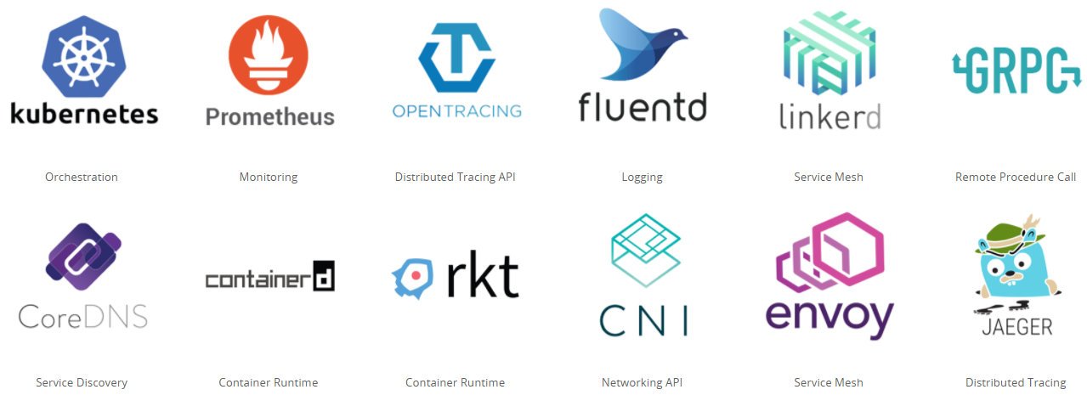
Cloud Native & Vendor Neutral
Cloud Native Computing Foundation - CNCF
All major – and not so major – vendors are member
Cloud Native: container packaged, dynamically managed, microservices oriented
Open technology for running container based workloads in a cross cloud vendor neutral way
Notes:
https://www.cncf.io/

Slide 83
Key constituents of Kubernetes
pod
cluster
Compute Node
container
Compute Node
Compute Node
Kubernetes

Slide 84
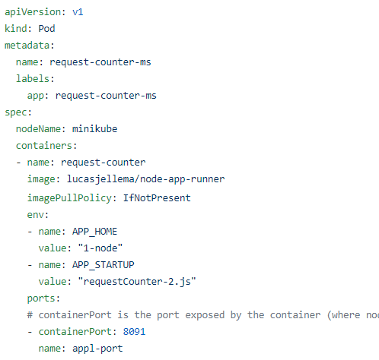
Key constituents of Kubernetes
pod
cluster
Compute Node
container
Compute Node
Compute Node
Kubernetes

Slide 85
Key constituents of Kubernetes
Some external consumer
pod
cluster
service
Compute Node
container
service
Compute Node
Compute Node
Kubernetes

Slide 86
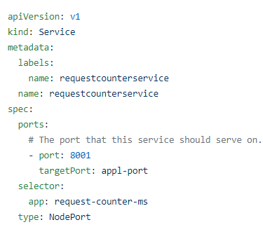
Key constituents of Kubernetes
pod
cluster
service
Compute Node
container
service
Compute Node
Compute Node
Kubernetes

Slide 87
Key constituents of Kubernetes
deployment
pod
service
Compute Node
pod
Compute Node
Compute Node
Kubernetes
cluster

Slide 88
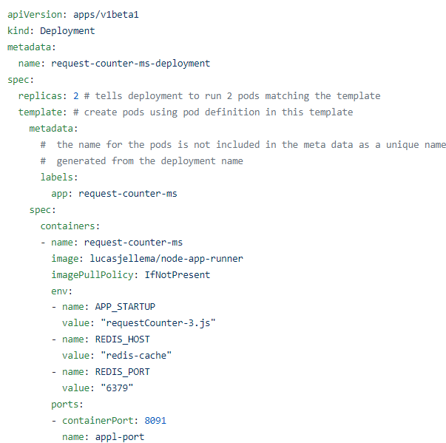
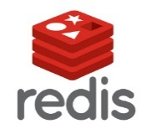
Key constituents of Kubernetes
deployment
pod
service
Compute Node
pod
Compute Node
Compute Node
Kubernetes
cluster

Slide 89
Key constituents of Kubernetes
namespace
namespace
service
Compute Node
service
Compute Node
Compute Node

Slide 90
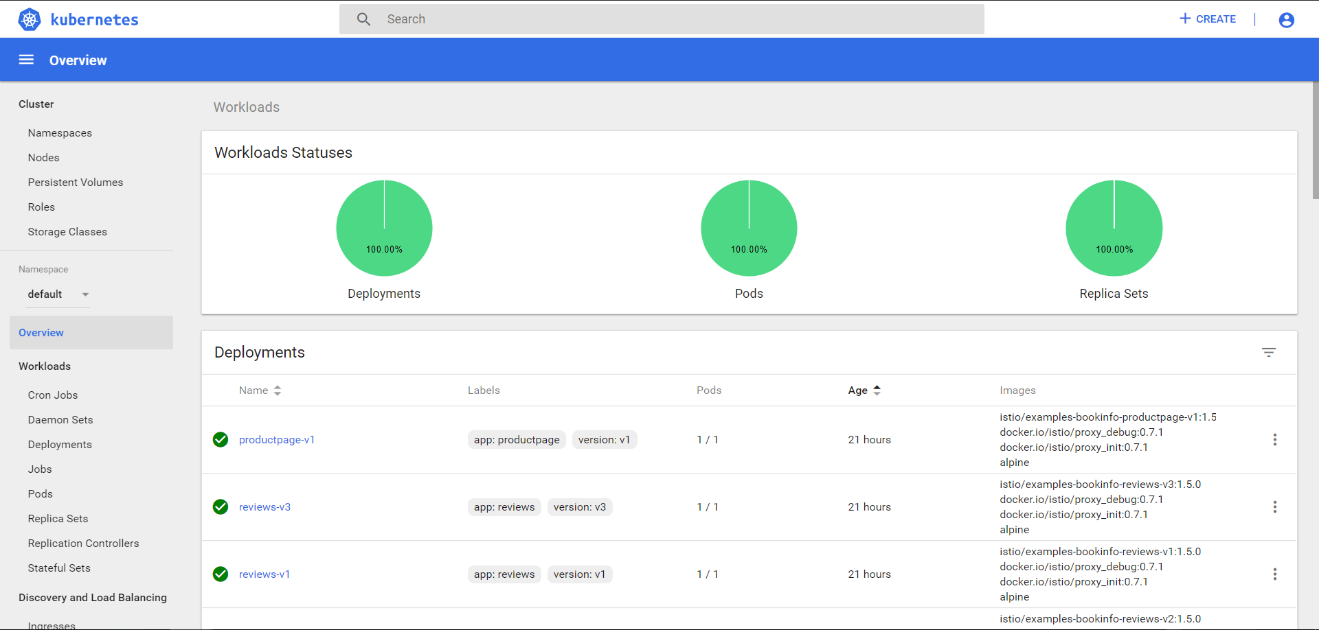

Slide 91
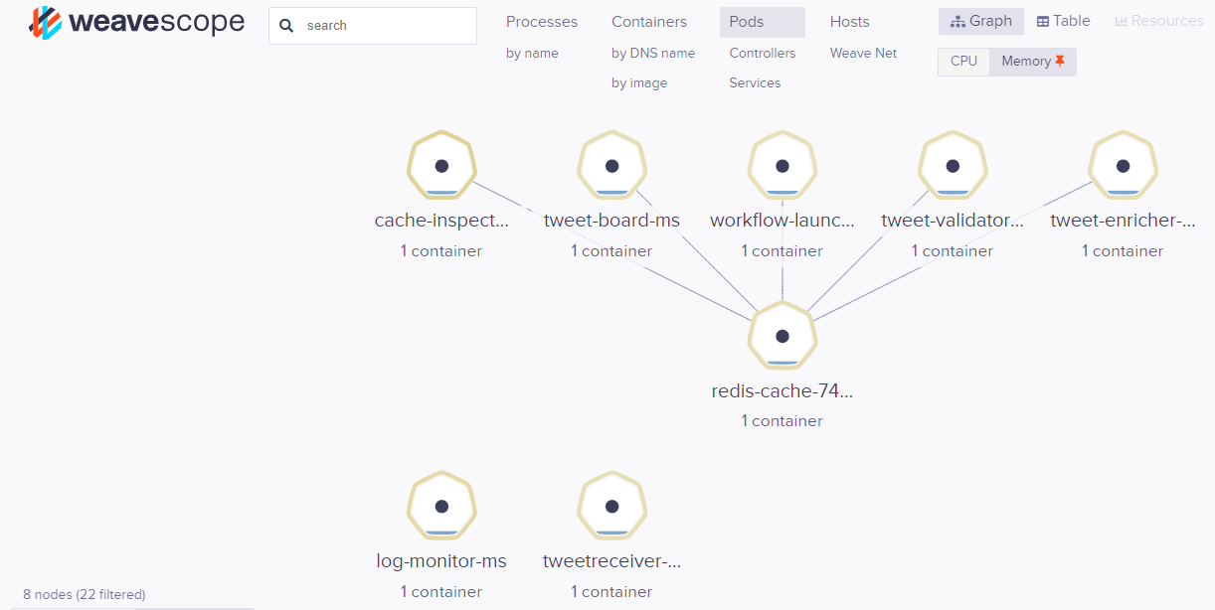
Visualizing Kubernetes Resources with WeaveScope

Slide 92
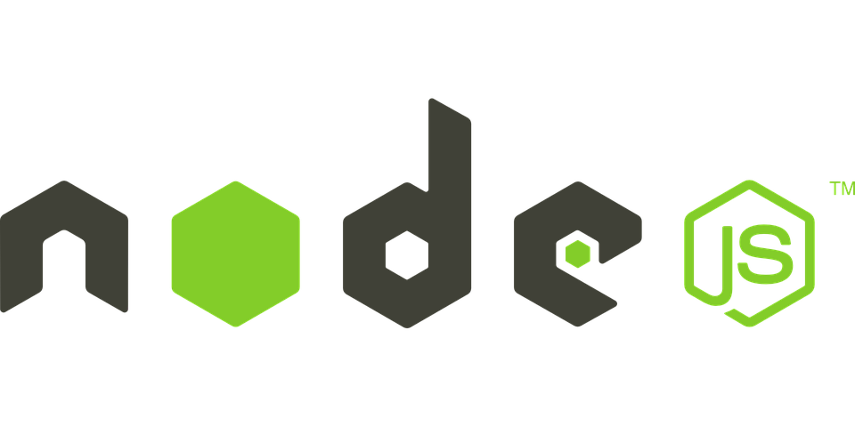


Handson Docker & Kubernetes
To get the slides and workshop materials: http://bit.ly/fontys1april

Slide 93
Real life microservices
Events
CQRS
Workflow
Cloud
Service Mesh

Slide 94

How microservices: design & implement
Business & Team ownership of application and associated platform
Automated CD – including regression test
Open (standards, protocols) on the outside, whatever you like inside
Deployable on enterprise standardized microservices platform
API & Event
Standard protocols for interaction
Horizontally scalable: multiple parallel instances
Stateless instances – horizontally scalable up & down, can handle fail over & restart
Private Bounded (Data) Context
Including derived data from other domains

Slide 95
Microservices State
Generic Platform for running microservices
LDAP
Big Data
Block Storage
Cache
RDBMS
NoSQL
Document Store
Event Hub
Notes:
All data stores are distributed
Or at least distributedly available
They can be local or on cloud (latency is important)
Data in generic data store is still owned by only one microservice – no one can touch it
Only in DWH and BigData do we deliberately take copies of data and disown them

Slide 96
Bounded context in microservices
A micoservice needs to be able to run independently
It needs to contain & own all data required to run
It cannot depend on other microservices
UI
API
Customer
API
Order
CustomerModified event

Slide 97
Products
Data Manipulation
Data Retrieval

Slide 98
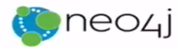



CQRS = Command Query Responsibility Segregation
Products
Data Manipulation
Quick Product Search Index
Special Products
Data Retrieval
Toys
Product Clusters
Product Store in SaaS app
Food Stuff
Notes:
Data manipulation and retrieval in separate places
(physical data proliferation)
Query store is optimized for consumers
Level of detail, format, filters applied
For performance and scalability, independence, productivity lower license fees and lower TCO, security

Slide 99

Comand Query Responsbility Segregation = CQRS
Detect changes
Products
Extract Data
Data Manipulation
Special Products
Data Retrieval
Toys
Quick Product Search Index
Product Clusters
Food Stuff
Product Store in SaaS app
Notes:
No Event Sourcing
No events (?)
No green field
Packages Applications/SaaS
Databases (RDBMS, NoSQL) getting changes from applications directly
Challenges – at scale, with enough speed and consistently: do not let query store get into an exposed state that could not exist/be right!
Detect relevant changes
Extract relevant changes
Transport
Convert
Apply in correct order and reliably (no lost events)
Note: after detect and extract, an event can be published

Slide 100
Microservices based Webshop
Web Shop Portal
µ Customers
µ Orders
µ Products
µ Loyalty
µ Finance
µ Logistics
µ Customers
µ Orders
µ Products
µ Loyalty
µ Finance
Notes:
dazzle the audience with a quick dump of all technologies (and cloud services) used for putting the webshop together - for the UI, the API implementation, the datastores and the event bus.

Slide 101



…. Event-(First) Driven
Event Monitor
Product Update
Product added to Shopping Cart
Shop
Products
Event Hub
Topic X
Topic Y
Topic Z
Topic Q
New Customer
Customer Profile Changed
Customer Sign In
Customers
Order Payment Received
Customer Frozen
Customer Loyalty Status Change
Order Create
Order Cancelled
Product Stock Update
Shipping News
Loyalty Program
Order
Logistics
Finance

Slide 102

API Gateway
Many other consumers
API Portal
Web Shop Portal
µ Customers
µ Orders
µ Products
µ Loyalty
µ Finance
API Platform

Slide 103
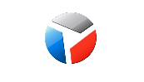



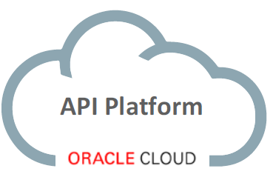



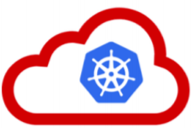




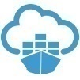




API Portal
Web Shop Portal
µ Customers
µ Orders
µ Products
µ Loyalty
µ Finance
API Platform
Backoffice UI
λ
Event Schema Registry
Event Hub
Notes:
dazzle the audience with a quick dump of all technologies (and cloud services) used for putting the webshop together - for the UI, the API implementation, the datastores and the event bus.

Slide 104



Heck, I do not even know these people and they may not know me [personally] – just my pearls of wisdom. And if they are late to the party, they can also check out the historic archives of my eloquence
Without fretting about the numbers of readers involved and whether they are in the same time zone as me and online when I publish my messages – and which device they use
It would be so nice if I could publish my ideas and actions, accessible near instantly for everyone who is interested

Slide 105


Heck, I do not even know these people and they may not know me [personally] – just my pearls of wisdom. And if they are late to the party, they can also check out the historic archives of my eloquence
Without fretting about the numbers of readers involved and whether they are in the same time zone as me and online when I publish my messages – and which device they use
It would be so nice if I could publish my ideas and actions, accessible near instantly for everyone who is interested

Slide 106


Decoupled communication
0, 1 or many followers
Scalable number of messages (and parties)
Reliable (mostly available, few messages lost)
Full history
Open: cross device, cross location
Not Sub-second, near real-time fast
Rate limited (#messages/minute)
Size limited (140-280 characters)
Format limited (text)
Not for private interactions
Not (really) for programmatic use

Slide 107
What does the Twitter for System Driven Event Interaction look like?
Decoupled communication – organized per topic
0, 1 or many Consumers per Topic
Scalable number of messages (and parties)
Reliable (distributed)
Full history
Open: libraries in many technologie & REST APIs

Slide 108
What does the Twitter for System Driven Event Interaction look like?
Decoupled communication – organized per topic
0, 1 or many Consumers per Topic
Scalable number of messages (and parties)
Reliable (distributed)
Full history
Open: libraries in many technologie & REST APIs
Near real-time fast
No Rate Limit
No enforced size limit
Anything goes (it’s all byte[])
On premises or in cloud, private or trusted
Very much for programmatic use

Slide 109
Events
Consumers
Producers
Robust, Scalable, Fast, History Retention
Containerized/Cloud-enabled
Open

Slide 110
Messaging as we know it
JMS, Oracle Advanced Queuing, IBM MQ, MS MQ, RabbitMQ, MQTT, XMPP, WebSockets, Apache Active MQ, AMQP , …
Challenges
Costs
Scalability (size and speed)
(lack of) Distribution (and therefore availability)
Complexity of infrastructure
Message delivery guarantees
Lack of technology openness
Deal with temporarily offline consumers
Retain history

Slide 111



Introducing Apache Kafka
..- 2010 – creation at Linkedin
Message Bus | Event Broker
High volume, low latency, highly reliable, cross technology
Scalable, distributed, strict message ordering, ….
2011/2012 – open source under the Apache Incubator/ Top Project
Kafka is used by many large corporations:
Walmart, Cisco, Netflix, PayPal, LinkedIn, eBay, Spotify, Uber, Sift Science, Zalando, The New York Times, Airbnb, Coursera, ING Bank,…
And embraced by many software vendors & cloud providers
Client libraries available for Node, Java, C/C++, Python, Ruby, PHP, Go, Rust, .NET, Perl, Scala DSL, Clojure, Swift and more
Commercial backing by and Enterprise support from Confluent

Slide 112
Consumers
tcp
Producers
tcp

Slide 113
Consumers
Producers
Topic

Slide 114
Kafka terminology
Topic
Message
== ByteArray
Broker
Producer
Consumer
Message
Key
Value
Time
Producer
Consumer
Broker
Topic

Slide 115
Key
Value
Time
Consumers
Producers
Broker
Topic

Slide 116
Consuming
Messages are available to consumers only when they have been committed
Kafka does not push
Unlike JMS
Read does not destroy
Unlike JMS Topic
(some) History available
Offline consumers can catch up
Consumers can re-consume from the past
Delivery Guarantees
Ordering maintained
At-least-once (per consumer) by default; at-most-once and exactly-once can be implemented

Slide 117
Key
Value
Time
Consumers
Producers
Broker
Topic

Slide 118



Consumers
tcp
Producers
tcp
Broker
Topic
Partition
Consumer Group

Slide 119
What’s so special?
Durable
Scalable
High volume
High speed
Available
Distributed
Open
Quick start
Free (no license costs)
“Self Fulfilling Prophecy” (positive feedback loop feeding from buzz around Kafka)
Eco system, tools/libraries/resources, cloud services

Slide 120

Ecosystem – Kafka and Friends
Clients
CLI
Java, Node/JavaScript, C/C++, Python, Go, Rust, .NET, Ruby, Clojure, Perl, …
REST Proxy
Kafka Schema Registry
Kafka Connect – read data and change events from many sources and/or write to many targets
Also see Debezium
Kafka Streams
Kafka KSQL

Slide 121


Getting Started with Apache Kafka
Get Access to an Apache Kafka Cluster environment
Download, Install, Configure and Run
Pull and Run a Docker Container (optionally on a Kubernetes cluster)
Sign up for a Managed Apache Kafka Cloud Service (e.g. Oracle Event Hub)
Configure Topic(s) & Partition(s) (optional)
Get an Apache Kafka Client Library
For Java, Spring Boot, Node, Python, …
Or expose Apache Kafka REST Proxy service
Develop Client Application to
Produce Events to Kafka Topic
Consume Events from Kafka Topic
Optionally
Use Schema Registry to design, publish and enforce event payload structure
Use Kafka Connect[ors] to integrate with specific source or sink technology
Use tooling for monitoring, tuning, reporting, administration, …
Topic

Slide 122
Develop Client Applications
Leveraging a precreated Event Hub Managed Kafka Topic in the cloud
Simple Node client
To publish message to Apache Kafka
using kafka-node npm module
Simple Java client
To consume messages from Apache Kafka
using org.apache.kafka.kafka_2.12 Maven dependency
Topic

Slide 123


Hands On Microservices on Kubernetes
Run Kafka on Minikube
Locally or on Katacoda
Deploy microservices & workflow orchestration

Slide 124
Summary
IT has to enable business objectives
Needs to be flexible
Microservices are a way to make IT manageable
Design time (Dev) and Run Time (Ops)
Containers and the Kubernetes platform enable isolated runtimes
Automated build and delivery, scalable, automated recovery and roll out
Increasingly relevant: Cloud Native - Serverless
Events are essential for decoupled interaction
Apache Kafka is the defacto standard event bus platform
Workflows executed by microservices are governed by workflow slips and choreographed through events
Technologies to learn more about:
Docker, Kubernetes, Kafka, Redis, WeaveScope, Katacoda
Bonus: Camunda, Istio, Traefik, Grafana, Prometheus, Kiali, Jaeger, …

Slide 125



Contact Details
Blog: technology.amis.nl
Email: lucas.jellema@amis.nl
: lucasjellema
: lucas-jellema
: www.amis.nl, info@amis.nl +31 306016000 Edisonbaan 15, Nieuwegein

Slide 126




Defining Workflow
Cross domain cutting concern
Composite transaction
Multi-step chain
Long running process
System initiated human participation
For example: the order flow
Submit order, check availability, collect payment, organize picking and shipping, and update loyalty status

Slide 127

Approaches
Orchestration
Choreography
Hybrid
Coordinated | Facilitated Choreography
Mixing orchestration and choreography

Slide 128

Desired Workflow
done
Tweet about JFall
Validate Tweet
No simple retweet, no black listed words used, no known robot tweeter or otherwise excluded authors, no undesirable location
Enrich Tweet
Add Tweet to TweetBoard
Publish TweetBoard
Details about author, location, hashtags, acronyms and abbreviations used in tweet
Add the tweet to the top of the TweetBoard – a list of recent, relevant tweets
Publish the TweetBoard through API and UI (HTML web document)

Slide 129


Microservices to map the workflow to
On premises
Tweet Board
Validate Tweet
REST/JSON
REST/JSON
Enrich Tweet
API
API
UI
API
Cache
Java SE/ Node.js
Java SE
Event Bus
NodeJS & Express in ACCS
Microservices Platform
Notes:
Workflow initiator responds to NewTweetEvent
Workflow Initiator - When tweet is for hashtag oraclecode then create routingslip document with tweet data, store in cache under key and publish workflow event for OracleCodeTwitterWorkflow with cache key for workflow state in payload
Validate Tweet – when OracleCodeTwitterWorkflow event – fetch workflow state from cache based on event payload, check routingslip to see if ValidateTweet should act; if so, validate tweet, update routing slip, retrieve and store in cache; publish workflow event for OracleCodeTwitterWorkflow with cache key for workflow state in payload
Enrich Tweet – when OracleCodeTwitterWorkflow event – fetch workflow state from cache based on event payload, check routingslip to see if EnrichTweet should act; if so, enrich tweet, update routing slip, retrieve and store in cache; publish workflow event for OracleCodeTwitterWorkflow with cache key for workflow state in payload
TweetBoard – when OracleCodeTwitterWorkflow event – fetch workflow state from cache based on event payload, check routingslip to see if TweetBoard should act; if so, add tweet to tweet list, update routing slip, retrieve-and-store in cache; publish workflow event for OracleCodeTwitterWorkflow with cache key for workflow state in payload
All microservices publish logging about their actions with the conversation identifier as part of the logging

Slide 130
Choreographed workflow
#hashtag
On premises
Tweet Receiver
Workflow Launcher
TweetBoard
Event Bus
API
API
Validate Tweet
API
UI
API
Cache
Enrich Tweet
Microservices Platform
Notes:
Workflow initiator responds to NewTweetEvent
Workflow Initiator - When tweet is for hashtag oraclecode then create routingslip document with tweet data, store in cache under key and publish workflow event for OracleCodeTwitterWorkflow with cache key for workflow state in payload
Validate Tweet – when OracleCodeTwitterWorkflow event – fetch workflow state from cache based on event payload, check routingslip to see if ValidateTweet should act; if so, validate tweet, update routing slip, retrieve and store in cache; publish workflow event for OracleCodeTwitterWorkflow with cache key for workflow state in payload
Enrich Tweet – when OracleCodeTwitterWorkflow event – fetch workflow state from cache based on event payload, check routingslip to see if EnrichTweet should act; if so, enrich tweet, update routing slip, retrieve and store in cache; publish workflow event for OracleCodeTwitterWorkflow with cache key for workflow state in payload
TweetBoard – when OracleCodeTwitterWorkflow event – fetch workflow state from cache based on event payload, check routingslip to see if TweetBoard should act; if so, add tweet to tweet list, update routing slip, retrieve-and-store in cache; publish workflow event for OracleCodeTwitterWorkflow with cache key for workflow state in payload
All microservices publish logging about their actions with the conversation identifier as part of the logging

Slide 131

Routing Slip published by workflow Launcher
If NOK, then done
Validate Tweet
Enrich Tweet
Add Tweet to TweetBoard
Publish TweetBoard

Slide 132
Routing Slip for completed workflow

Slide 133
Choreographed workflow
#hashtag
On premises
Tweet Receiver
Enrich Tweet
Workflow Launcher
TweetBoard
Event Bus
API
API
Validate Tweet
API
UI
API
Cache
Microservices Platform
Notes:
Workflow initiator responds to NewTweetEvent
Workflow Initiator - When tweet is for hashtag oraclecode then create routingslip document with tweet data, store in cache under key and publish workflow event for OracleCodeTwitterWorkflow with cache key for workflow state in payload
Validate Tweet – when OracleCodeTwitterWorkflow event – fetch workflow state from cache based on event payload, check routingslip to see if ValidateTweet should act; if so, validate tweet, update routing slip, retrieve and store in cache; publish workflow event for OracleCodeTwitterWorkflow with cache key for workflow state in payload
Enrich Tweet – when OracleCodeTwitterWorkflow event – fetch workflow state from cache based on event payload, check routingslip to see if EnrichTweet should act; if so, enrich tweet, update routing slip, retrieve and store in cache; publish workflow event for OracleCodeTwitterWorkflow with cache key for workflow state in payload
TweetBoard – when OracleCodeTwitterWorkflow event – fetch workflow state from cache based on event payload, check routingslip to see if TweetBoard should act; if so, add tweet to tweet list, update routing slip, retrieve-and-store in cache; publish workflow event for OracleCodeTwitterWorkflow with cache key for workflow state in payload
All microservices publish logging about their actions with the conversation identifier as part of the logging

Slide 134



Workflow in action

Slide 135


Workflow in action

Slide 136





Microservice Choreography Topology
Tweet
Receiver
Workflow Launcher
Tweet
Validator
Tweet
Enricher
Tweet
Board
Cache
Cache Inspector
LogMonitor
Event Bus

Slide 137
Choreography partners – Pods in Kubernetes

Slide 138
Extending the workflow choreography – with translation of the tweet
If NOK, then done
Translate Tweet
Validate Tweet
Enrich Tweet
Add Tweet to TweetBoard
Publish TweetBoard

Slide 139
Extending the workflow choreography – with translation of the tweet
Implement microservice for
Translating tweets
Participating in Workflow
Deploy microservice – with access to Event Bus & Cache
Extend Workflow Template
Add new ‘translation’ step – dependency on Enrich Tweet
Change current ‘tweetboard’ step – modify dependency to Translation
If NOK, then done
Validate Tweet
Enrich Tweet
Translate Tweet
Add Tweet to TweetBoard
Publish TweetBoard

Slide 140

Choreographed workflow
#hashtag
On premises
Translate Tweet
Tweet Receiver
Enrich Tweet
Workflow Launcher
TweetBoard
Event Bus
API
API
Validate Tweet
API
API
API
UI
API
Cache
Microservices Platform
Notes:
Workflow initiator responds to NewTweetEvent
Workflow Initiator - When tweet is for hashtag oraclecode then create routingslip document with tweet data, store in cache under key and publish workflow event for OracleCodeTwitterWorkflow with cache key for workflow state in payload
Validate Tweet – when OracleCodeTwitterWorkflow event – fetch workflow state from cache based on event payload, check routingslip to see if ValidateTweet should act; if so, validate tweet, update routing slip, retrieve and store in cache; publish workflow event for OracleCodeTwitterWorkflow with cache key for workflow state in payload
Enrich Tweet – when OracleCodeTwitterWorkflow event – fetch workflow state from cache based on event payload, check routingslip to see if EnrichTweet should act; if so, enrich tweet, update routing slip, retrieve and store in cache; publish workflow event for OracleCodeTwitterWorkflow with cache key for workflow state in payload
TweetBoard – when OracleCodeTwitterWorkflow event – fetch workflow state from cache based on event payload, check routingslip to see if TweetBoard should act; if so, add tweet to tweet list, update routing slip, retrieve-and-store in cache; publish workflow event for OracleCodeTwitterWorkflow with cache key for workflow state in payload
All microservices publish logging about their actions with the conversation identifier as part of the logging

Slide 141


Modified workflow template
API
API
Translate Tweet
Tweet Board
UI
API

Slide 142



Result on tweet board including translation

Slide 143
Hands On Microservices on Kubernetes
Run Kafka on Minikube
Locally or on Katacoda
Deploy microservices & workflow orchestration

Slide 144
Summary
IT has to enable business objectives
Needs to be flexible
Microservices are a way to make IT manageable
Design time (Dev) and Run Time (Ops)
Containers and the Kubernetes platform enable isolated runtimes
Automated build and delivery, scalable, automated recovery and roll out
Increasingly relevant: Cloud Native - Serverless
Events are essential for decoupled interaction
Apache Kafka is the defacto standard event bus platform
Workflows executed by microservices are governed by workflow slips and choreographed through events
Technologies to learn more about:
Docker, Kubernetes, Kafka, Redis, WeaveScope, Katacoda
Bonus: Camunda, Istio, Traefik, Grafana, Prometheus, Kiali, Jaeger, …

Slide 145
Contact Details
Blog: technology.amis.nl
Email: lucas.jellema@amis.nl
: lucasjellema
: lucas-jellema
: www.amis.nl, info@amis.nl +31 306016000 Edisonbaan 15, Nieuwegein

